Slide 1

Optimizing Car Prices: A Data-Driven Approach
Leveraging Linear Regression for Informed Decision-Making

Slide 2


Project Overview
Objective: Understand factors influencing car prices
Methodology: Linear Regression Analysis
Significance: Informed decision-making for car sellers

Slide 3
Data Collection and Variables
Data Source: Comprehensive dataset on car listings
Variables: Make, Year of Manufacture (YOM), Mileage, Used status, Transmission type, City
Encoding: Categorical variables transformed for analysis

Slide 4
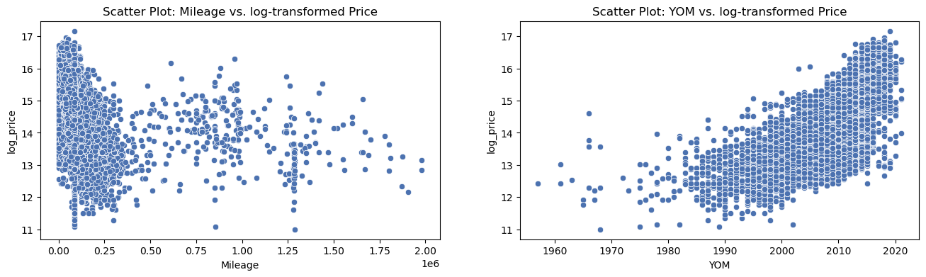
Insights from Initial Visualizations
Scatter plots: Mileage vs. log-transformed Price, YOM vs. log-transformed Price
Initial observations: Mileage influences pricing; newer cars correlate with higher prices

Slide 5
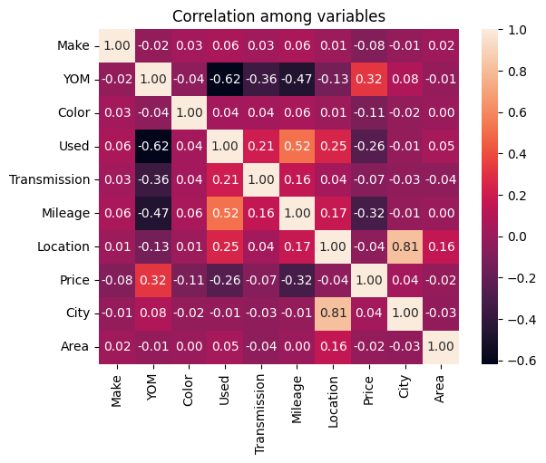
Correlation Analysis
Explore relationships between car features and prices
Highlight: Positive and negative correlations, visualized heatmaps
Identified: Color impact on prices, indicating potential customer preferences

Slide 6
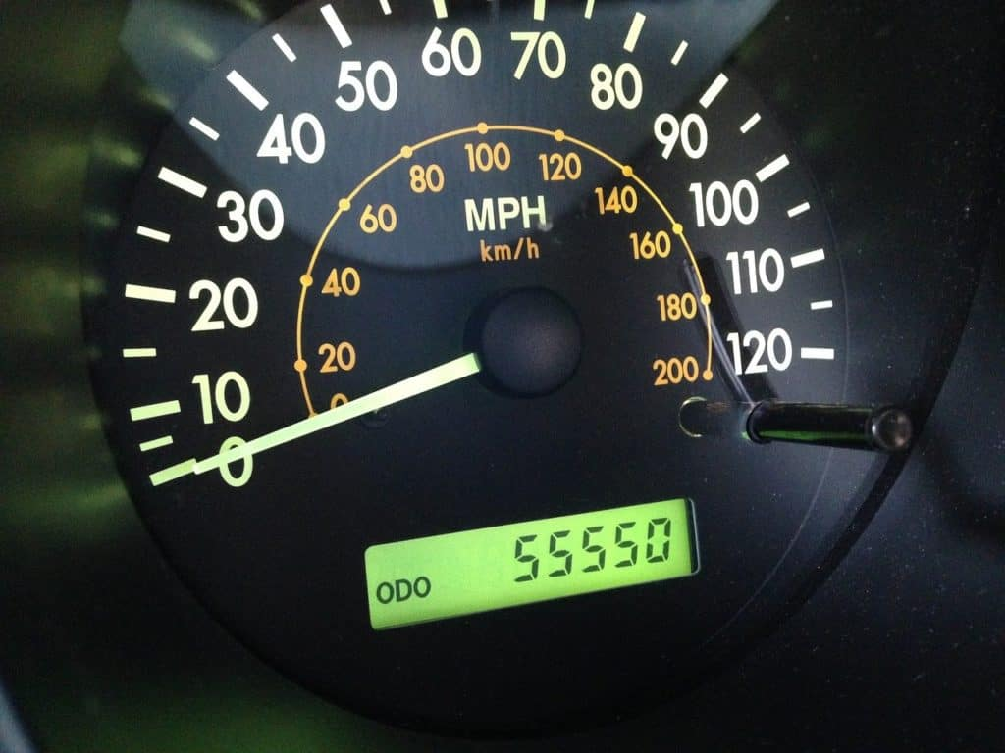
ANOVA Tests for Mileage and YOM
Hypotheses: Significant differences in log price based on Mileage and YOM
Results: Strong evidence against null hypothesis, indicating influential relationship between individual factors
Actionable Insights: Consider Mileage and YOM as predictors for pricing decisions

Slide 7

Linear Regression - Baseline Model
Initial model: Log-transformed Price ~ Used status
Coefficient Interpretation: Used status impacts prices
Significance: Strong evidence (p-value = 0.000) supports relationship

Slide 8
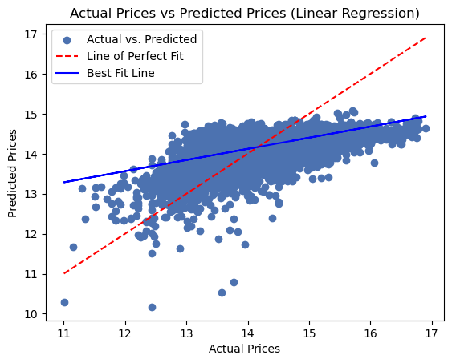
Linear Regression - Multiple Variables
Expanded model: Log-transformed Price ~ Make, YOM, Mileage, Used, Transmission, City
Coefficients: Influence of each variable on pricing
Significance: P-values validate variables as significant predictors

Slide 9

Model Performance Comparison
Baseline Model: RMSE - 0.7163, R-squared - 0.143
Multiple Linear Regression: RMSE - 0.6613, R-squared - 0.281
Interpretation: Multiple Linear Regression shows better predictive accuracy and goodness of fit

Slide 10
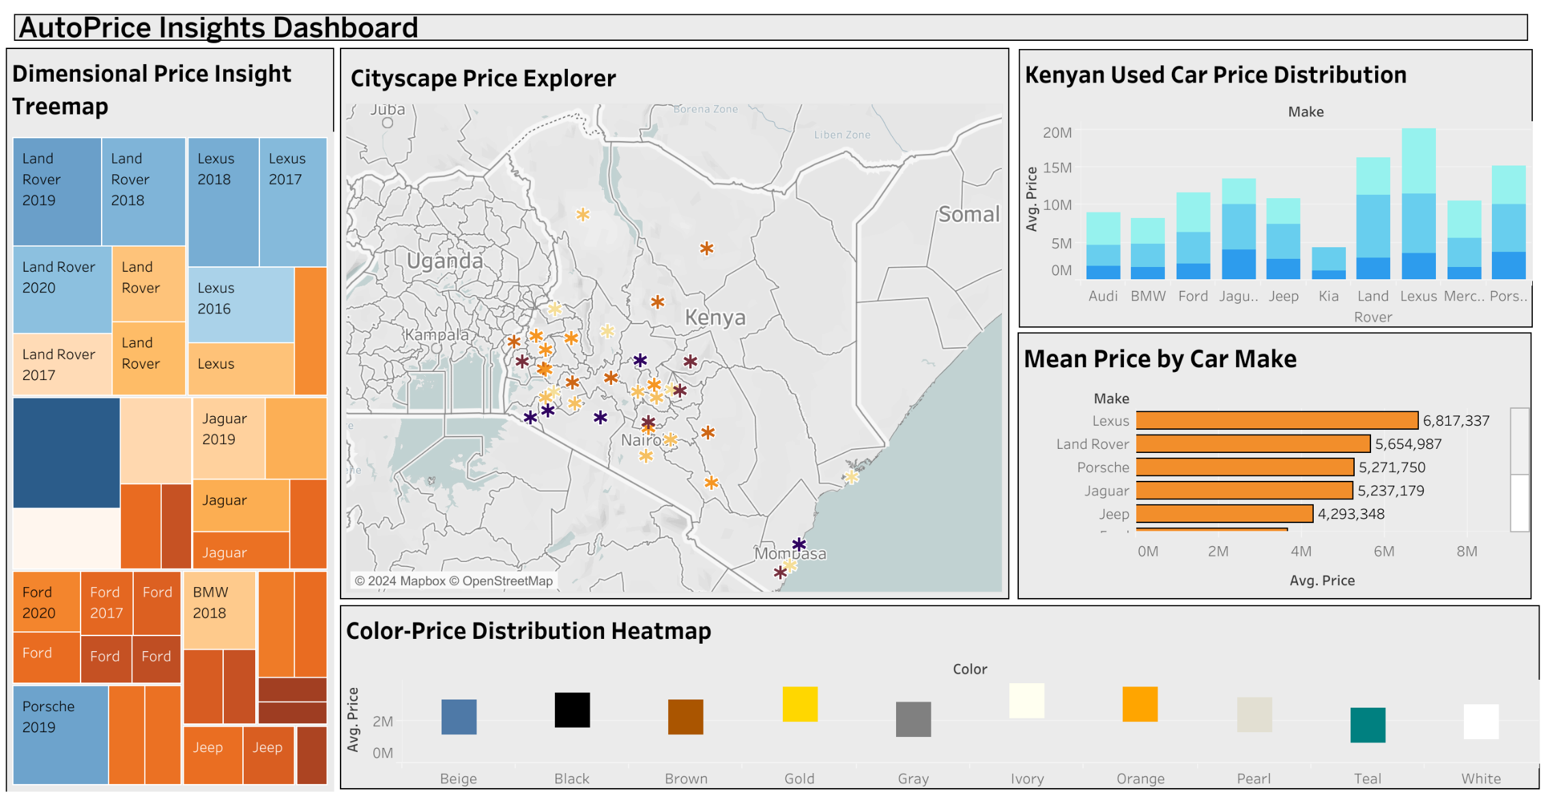
Tableau Dashboard Visualization
Dimensional Price Insight: This section shows the average price of used cars in Kenya by city. The city with the highest average price is Nairobi, followed by Mombasa and Kisumu.
Cityscape Price Explorer: This section shows the average price of used cars in Kenya by city, as well as the distribution of prices by make and model. The city with the highest average price for Land Rovers is Nairobi, followed by Mombasa and Kisumu. The city with the highest average price for Lexus is Nairobi, followed by Mombasa and Kisumu.
Kenyan Used Car Price Distribution: This section shows the distribution of used car prices in Kenya by color. The most common color for used cars in Kenya is white, followed by gray and silver. The color with the highest average price is white, followed by silver and gray.

Slide 11


Slide 12

Recommendations for Car Sellers
Prioritize brand new cars for higher prices
Emphasize AMT transmission for premium pricing
Highlight newer cars for positive influence
Promote low-mileage cars for increased pricing
Consider city-wise strategies for optimized pricing

Slide 13

Thank You

